Slide 1
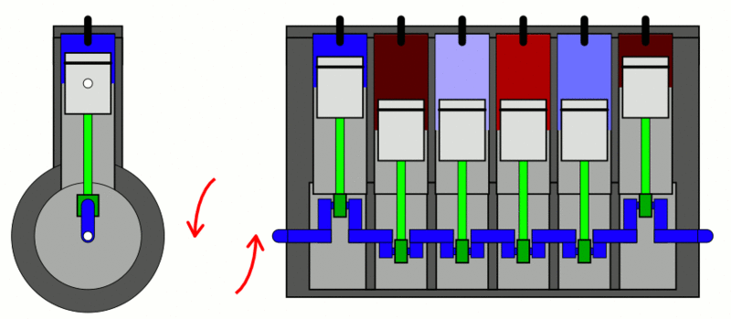
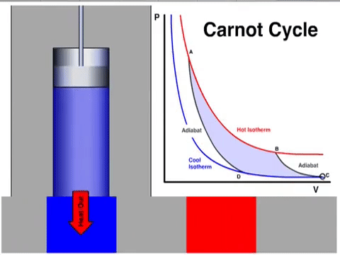
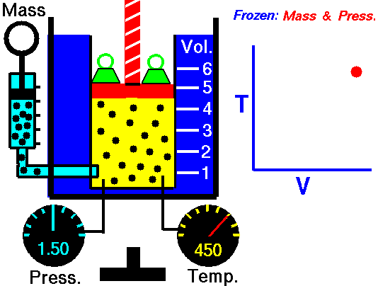
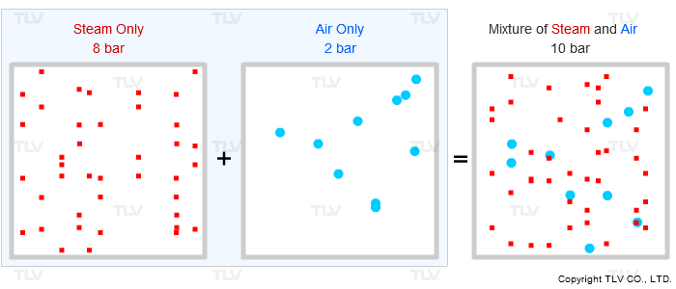
CH21201 Chemical Engineering Thermodynamics

Slide 2
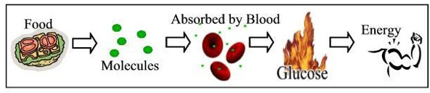

How our body works?
How a bullet works?

Slide 3
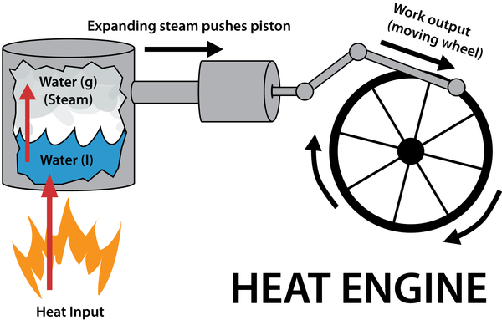
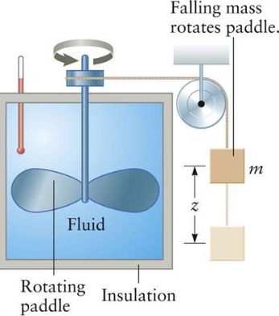
Interconvertibility of Heat & WORK

Slide 4
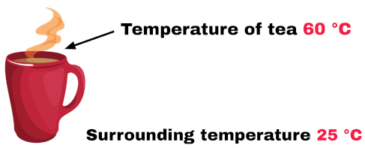


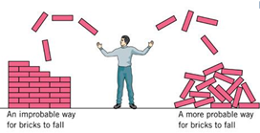
Feasibility of a Process

Slide 5
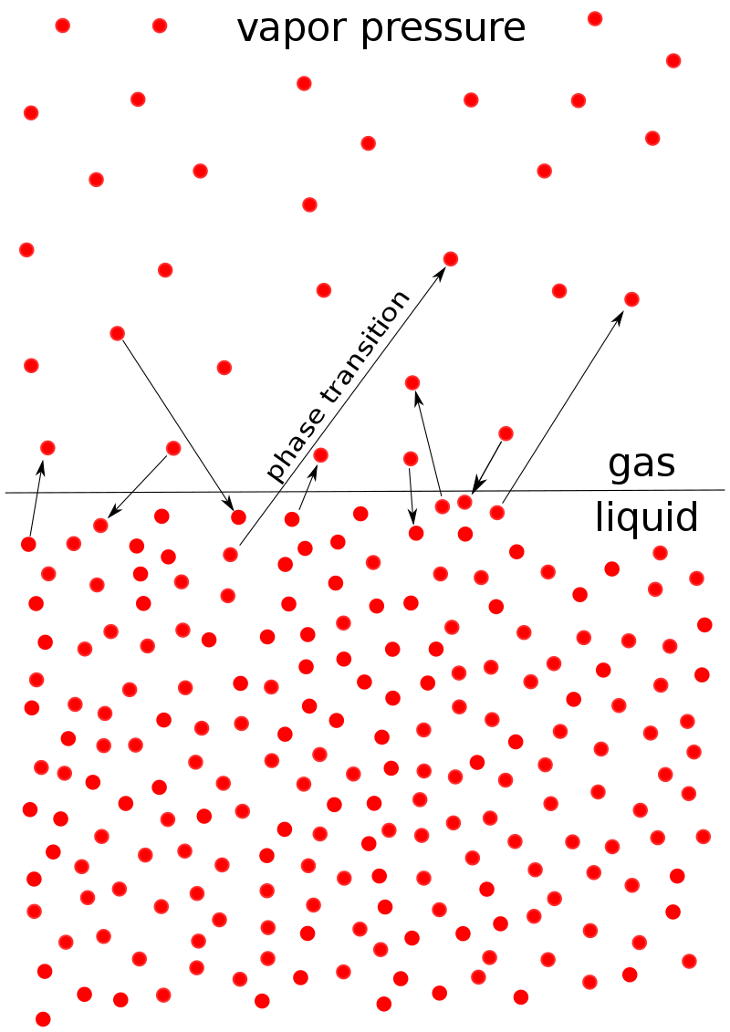
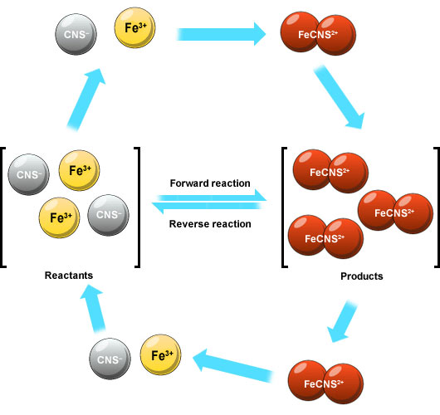
Extent of a Process
EQUILIBRIUM: Thermal, Mechanical, Chemical
We deal with kinetics of heat /mass transfer in separate course.
Thermodynamics always deals with equilibrium processes.

Slide 6
Thermodynamics (Laws of NATURE)
based on numerous observations
Intuitive
human origin
Formulation involves primitive and intuitive concepts derived from common experience.
valid for a broad class of phenomena.

Slide 7
Thermodynamics
Energy and its transformation
Feasibility of a Process
Equilibrium (Extent of Change)
Thermodynamics: deals with the relationship between heat and work, and the properties of system in equilibrium.
Thermodynamics and economics: The laws of the conservation of energy and of the increase of entropy constrain the processes by which raw materials are transformed into consumable goods, and therefore have implications for the way economists model these processes

Slide 8
All these laws are based on a large number of Experimental observation (deduced through logical reasoning).
Hence these laws can’t be proved like theorems.
Validity lies in agreement between the experimental results and predictions made by these laws.
Two approaches:
Macroscopic (Classical) Microscopic (Statistical)
Directly based on observation of Macroscopic properties.(no need to bother about detailed structural features)
Advantage: In engineering applications relation between various macroscopic properties are important rather than understanding of material behavior in terms of microscopic structural details.
Detailed information of microstructure (atomic/molecular)
Macroscopic properties obtained via statistical averaging over large number of atoms/molecules.
(mathematically very rigorous)

Slide 9

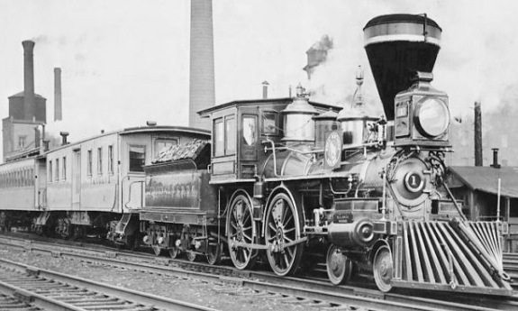
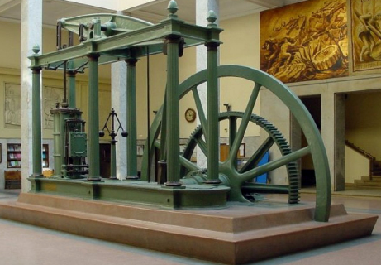
Timeline for HEAT → WORK
1680 - Christiaan Huygens
a piston engine powered by gunpowder
1690 - Denis Papin - produces design for the first piston steam engine.
1698 - Thomas Savery builds a pistonless steam-powered water pump for pumping water out of mines.
First Homo sapiens
2,00,000 years ago
1769 - James Watt , steam engine (doubling the efficiency of earlier engines)
1812–13 by John Blenkinsop

Slide 10

HEAT (ENERGY IN TRANSITION)
History: a invisible odorless, massless fluid (caloric) flowing from hot to cold body.
Heat is a substance that could not be created or destroyed.
Heat is defined as the form of energy that is transferred between two systems (or a system and its surroundings) by virtue of a temperature difference . Thus an energy interaction is heat only if it takes place because of a temperature difference.

Slide 11
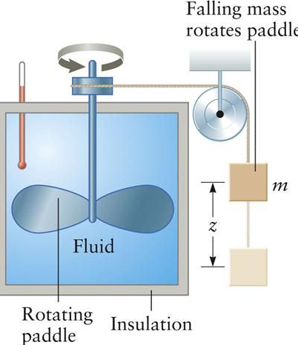
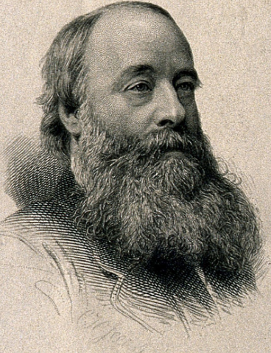
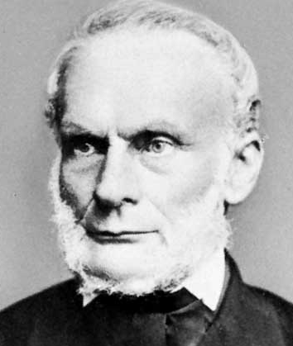
1843 – James Joule experimentally finds the mechanical equivalent of heat.
First formal statement of first law of thermodynamics,
by Rudolf Clausius in 1850.
In all cases in which work is produced by the agency of heat, a quantity of heat is consumed which is proportional to the work done; and conversely, by the expenditure of an equal quantity of work an equal quantity of heat is produced

Slide 12
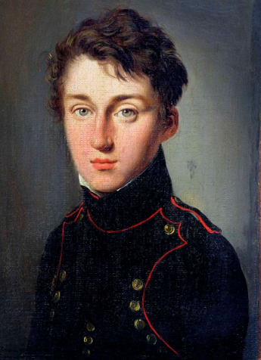
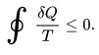
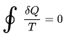
Carnot's theorem (1824)
All irreversible heat engines between two heat reservoirs are less efficient than a Carnot engine operating between the same reservoirs.
Sadi Carnot (1796 – 1832)
a French military scientist and physicist
The Clausius theorem (1854) states that in a cyclic process:
for a reversible process:
SECOND law of Thermodynamics
Origin of Entropy, Exergy,
Availability
Feasibility of a Process

Slide 13
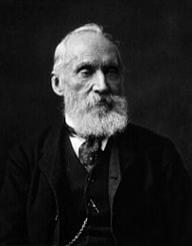
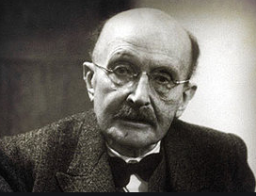
1848
It is impossible for a self-acting machine, unaided by any external agency, to convey heat from one body to another at a higher temperature.
Max Planck: It is impossible to construct an engine which will work in a complete cycle, and produce no effect except the raising of a weight and cooling of a heat reservoir.
William Thomson, 1st Baron Kelvin
Zeroth Law of Thermodynamics
In 1897 Max Planck said, "If a body, A, be in thermal equilibrium with two other bodies, B and C, then B and C are in thermal equilibrium with one another."

Slide 14
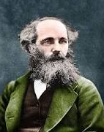
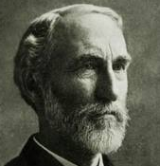
1859 – James Clerk Maxwell discovers the distribution law of molecular velocities (microscopic approach/ Statistical approach)
1876 – Josiah Willard Gibbs (An American Scientist) publishes the first of two papers, which discuss phase equilibrium, statistical ensembles, the free energy as the driving force behind chemical reactions, and chemical thermodynamics in general.
(broadened the scope of Thermodynamics, so that it can be applied to any complex system)
His work on the applications of thermodynamics was instrumental in transforming the subject into a rigorous inductive science.

Slide 15
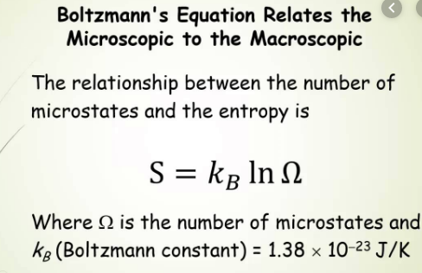
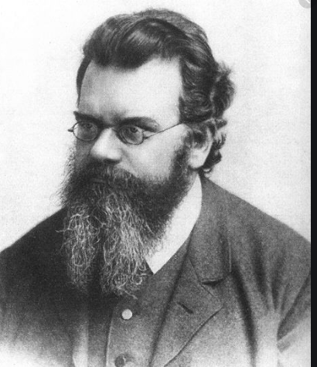
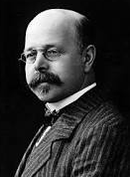
1877 – Boltzmann states the relationship between entropy and probability
Statistical Approach ( very generic & applicable to any statistical phenomenon)
1906–12
Third Law by Walther Nernst
The entropy of a system approaches a constant value as its temperature approaches absolute zero.

Slide 16
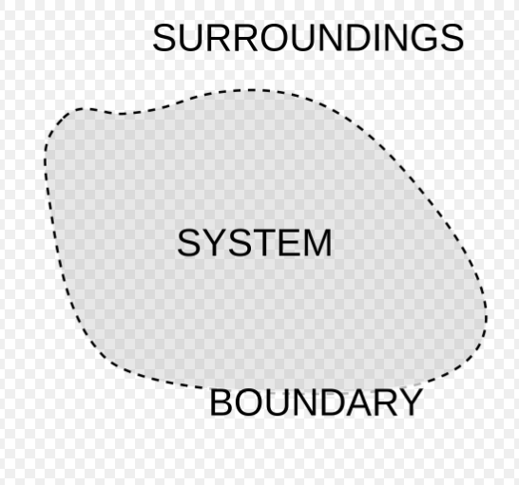
System Properties
Distinguishing characteristics of a system.
Macroscopic description of a system.
Either directly or indirectly observable
Collection of matter
(physical or imaginary)
Exchange of Heat and Work while material interacts with surrounding.

